Slide 1
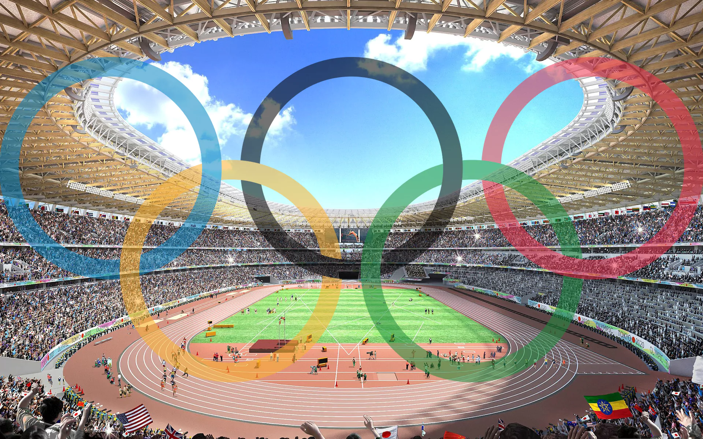
Inside the Olympics
Juan Pablo Harfush
Luis Delfín
Gabriel Reynoso

Slide 2
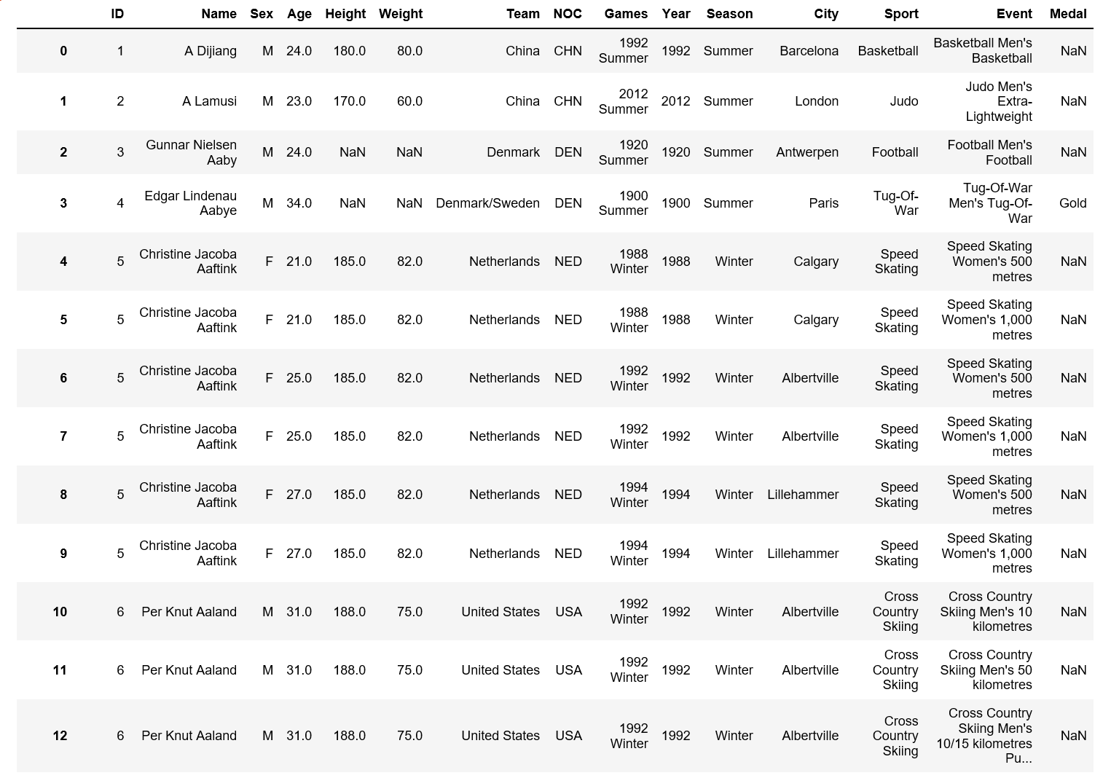
Data Set Description

Slide 3

Is there more to know about the olympics…?

Slide 4
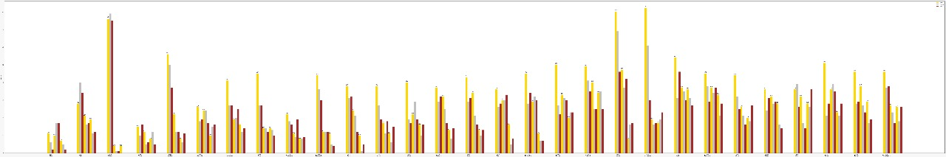
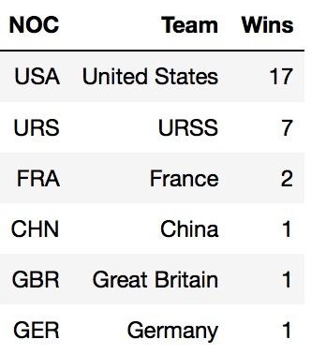
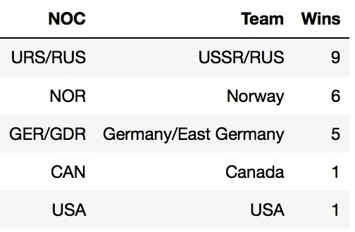
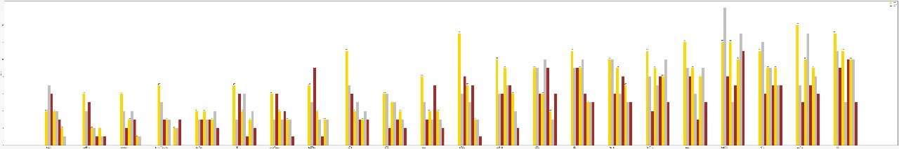
Summer
World Domination
Winter

Slide 5
Who has dominated the Summer Olympics over the years?

Slide 6
Who has dominated the Winter Olympics over the years?

Slide 7
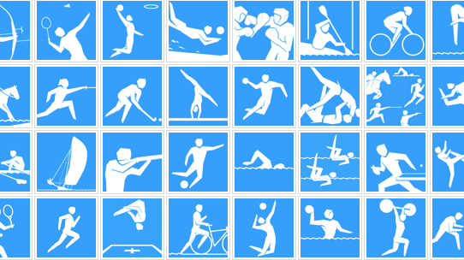
Domination by Sports

Slide 8
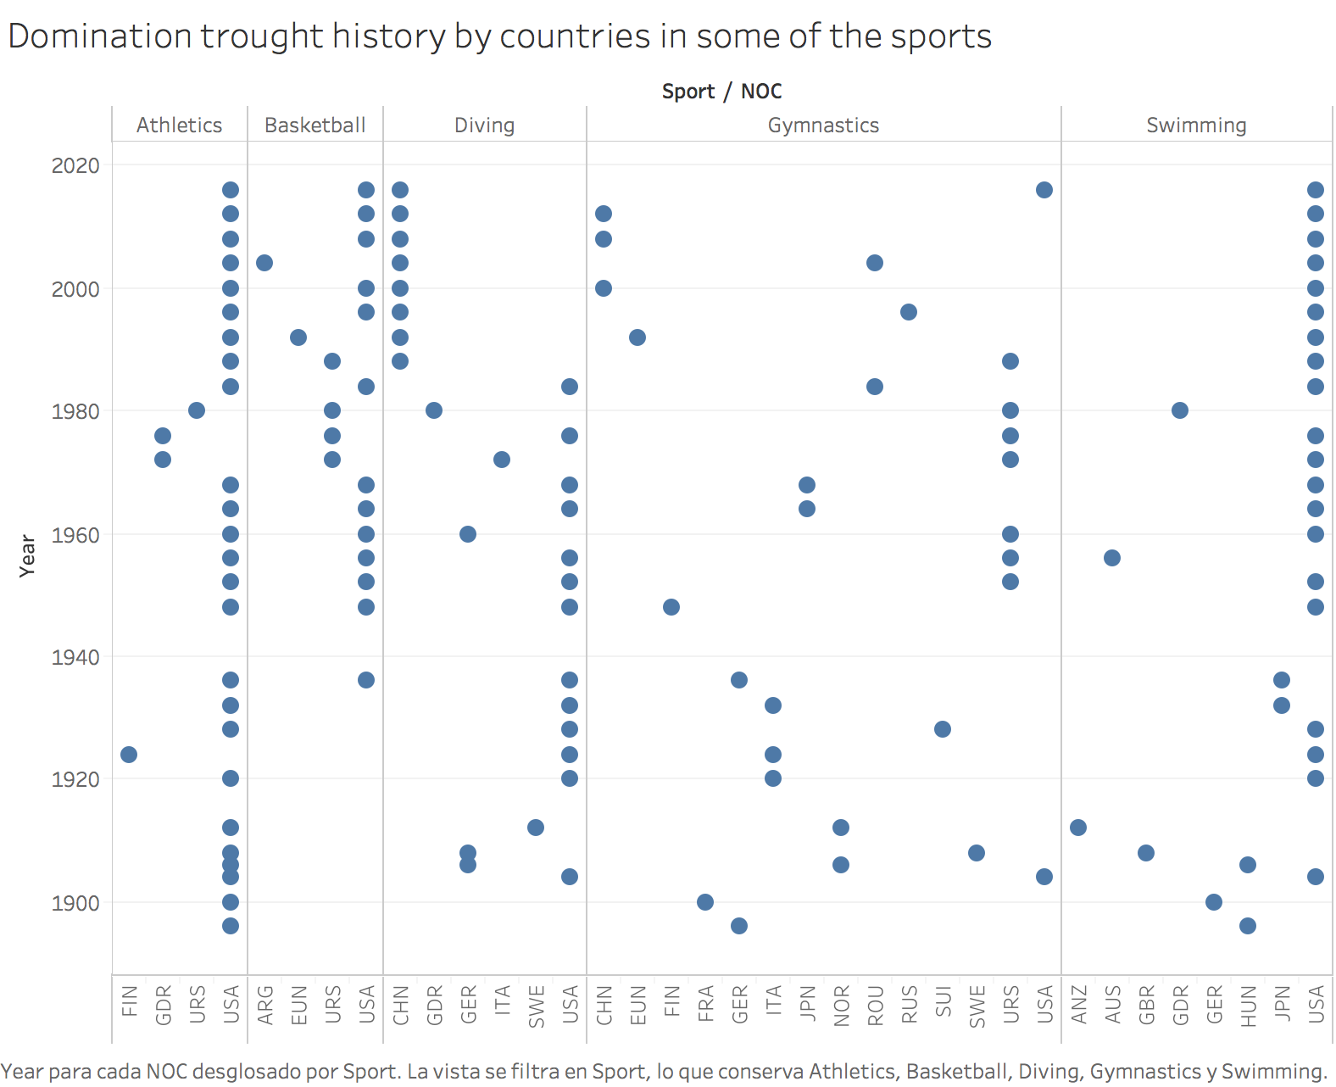

Slide 9

Do hosts have any advantages?

Slide 10
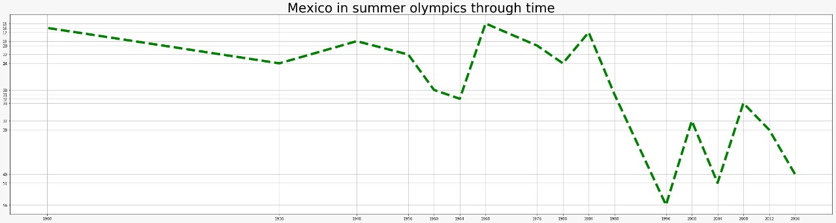
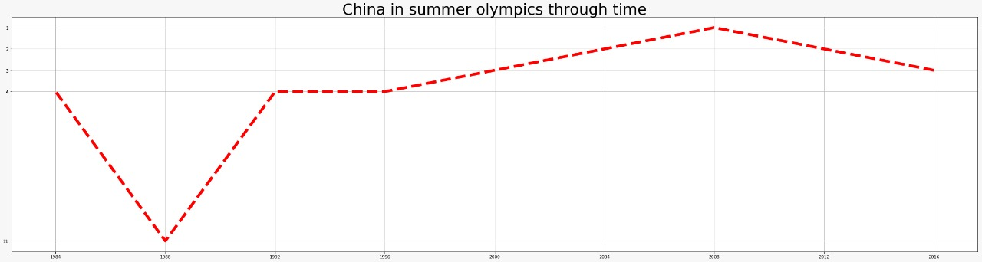
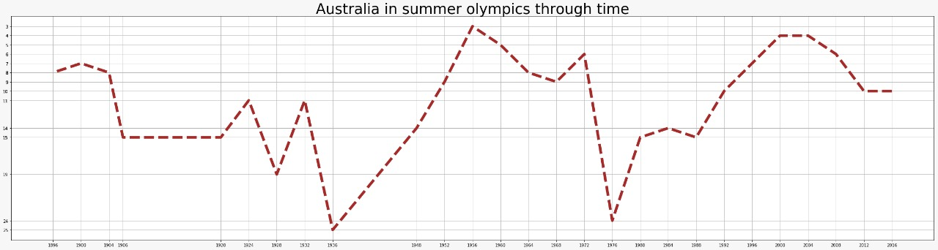
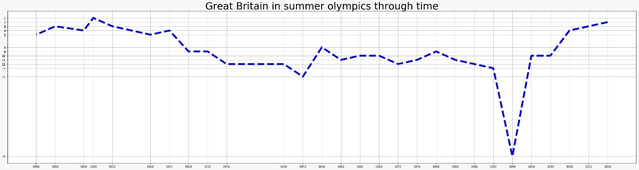
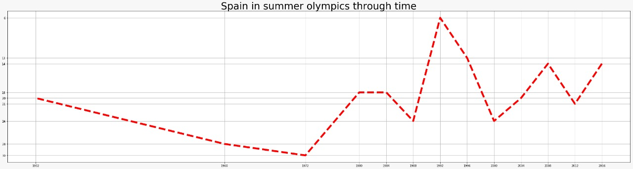
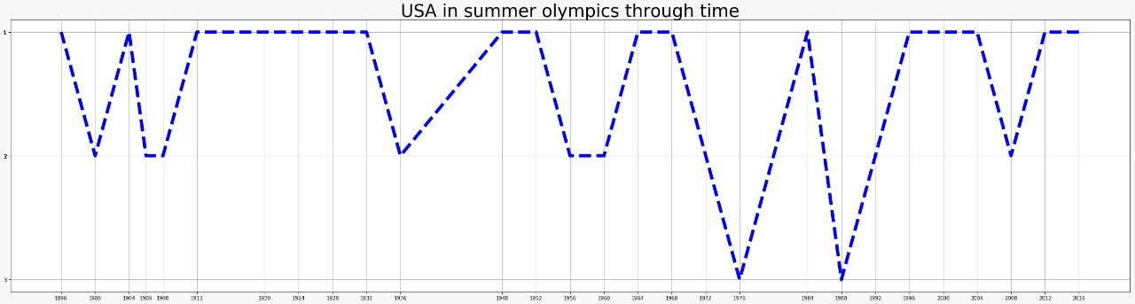
Summer Olympics

Slide 11
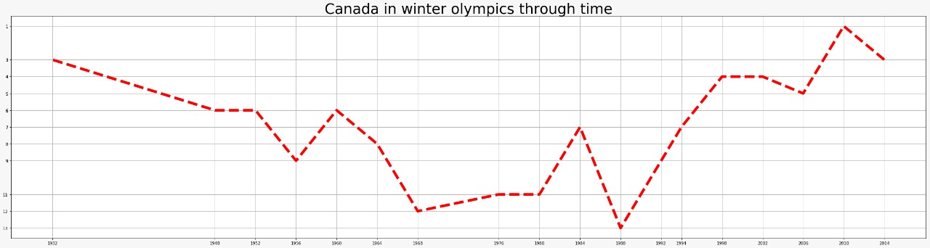
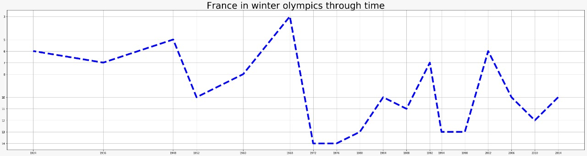
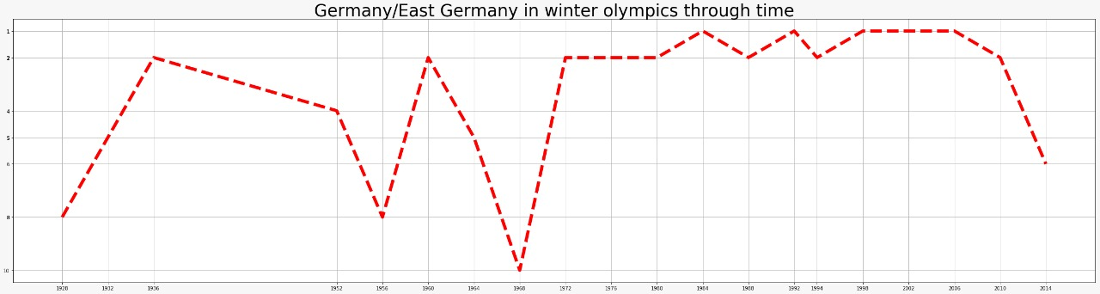
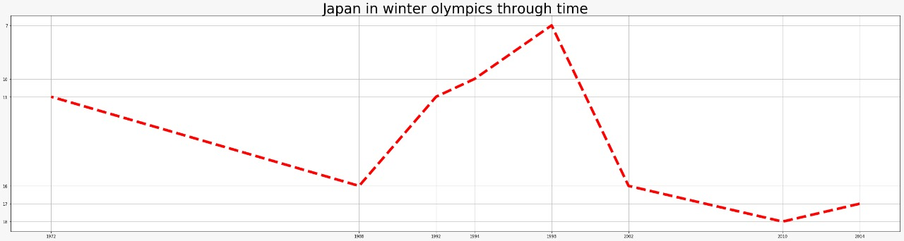
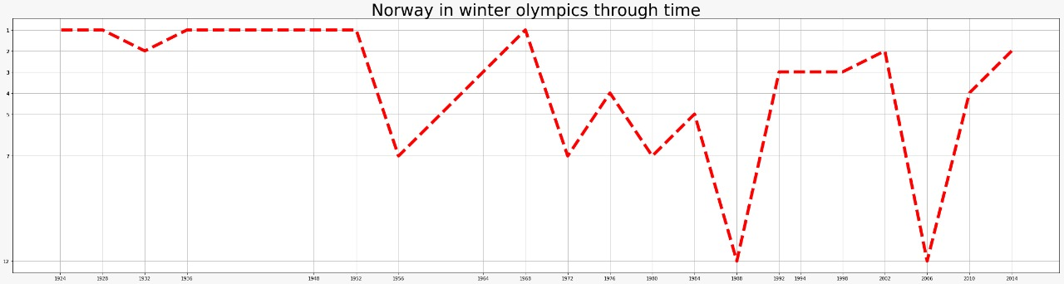
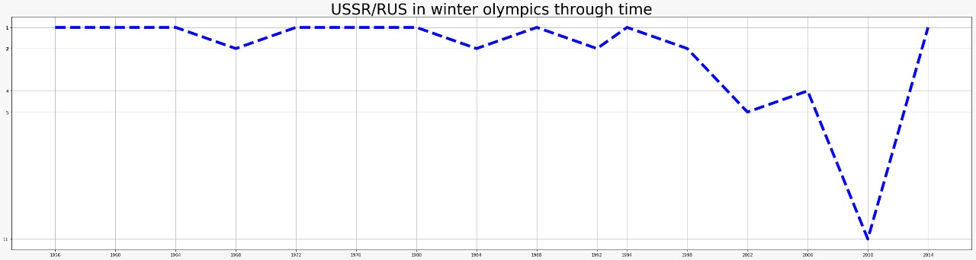
Winter Olympics

Slide 12
Olympic’s Host Metric
Parameter/Season | Summer | Winter
Mean | 4.1640 | 0.5548
Standard Deviation | 4.7873 | 1.9448

Slide 13
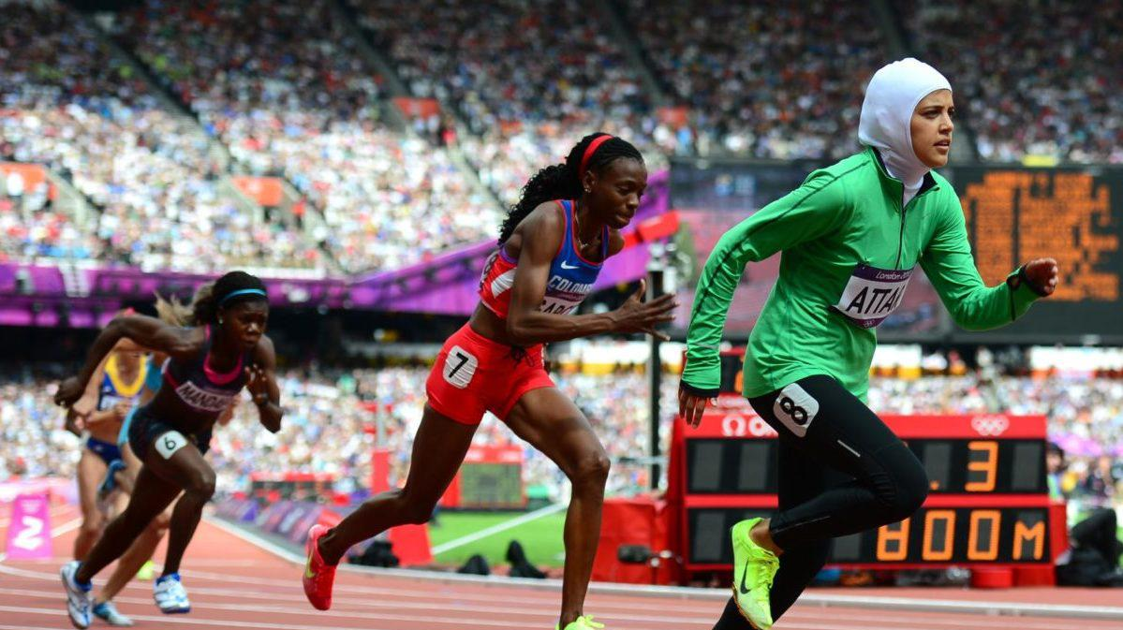
Women in the Olympics.

Slide 14
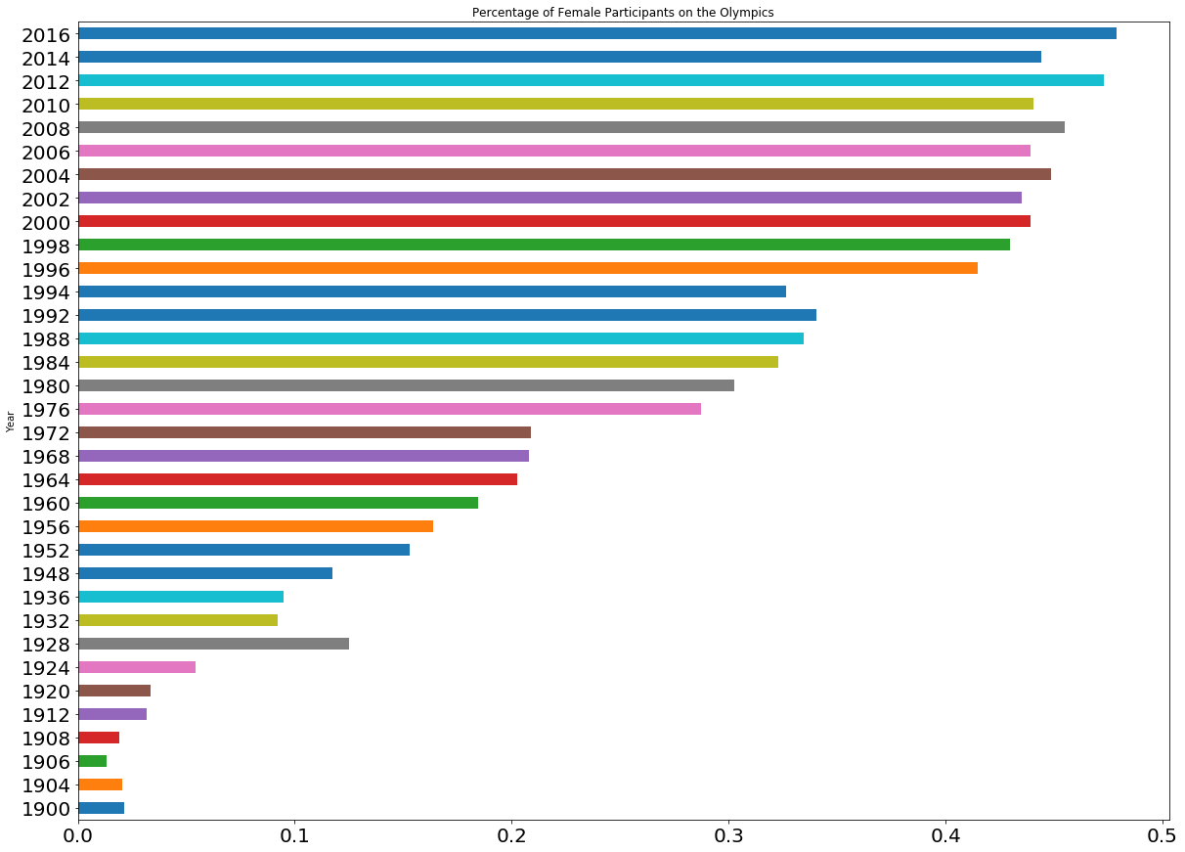
Women’s Participation
Percentage of Female Participants on the Olympics
The percentage of female participants on the Olympics has grown since they where first included on 1900 in Paris.
On the last Olympics, almost have of the athletes were women.
Year
Percentage

Slide 15
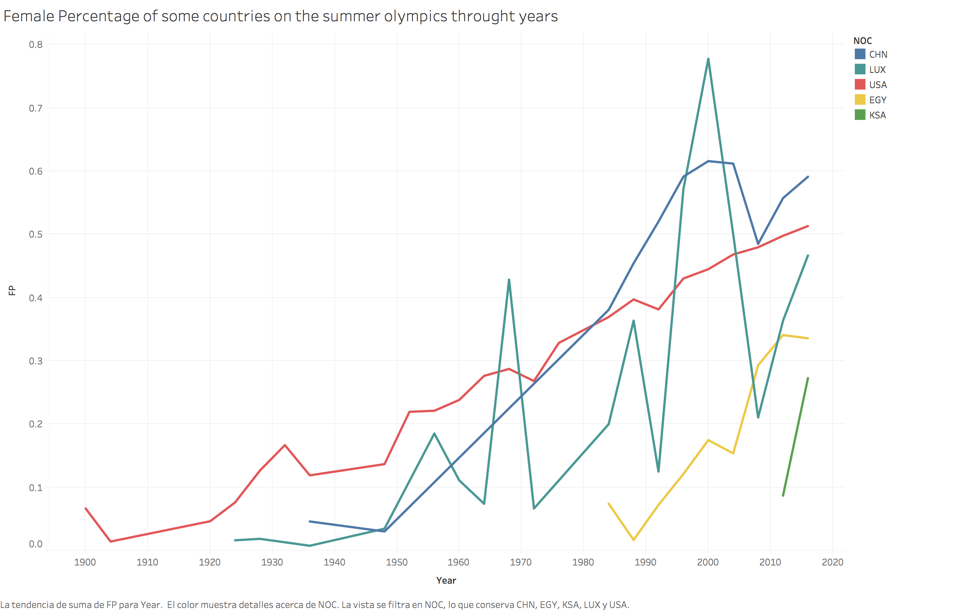

Slide 16
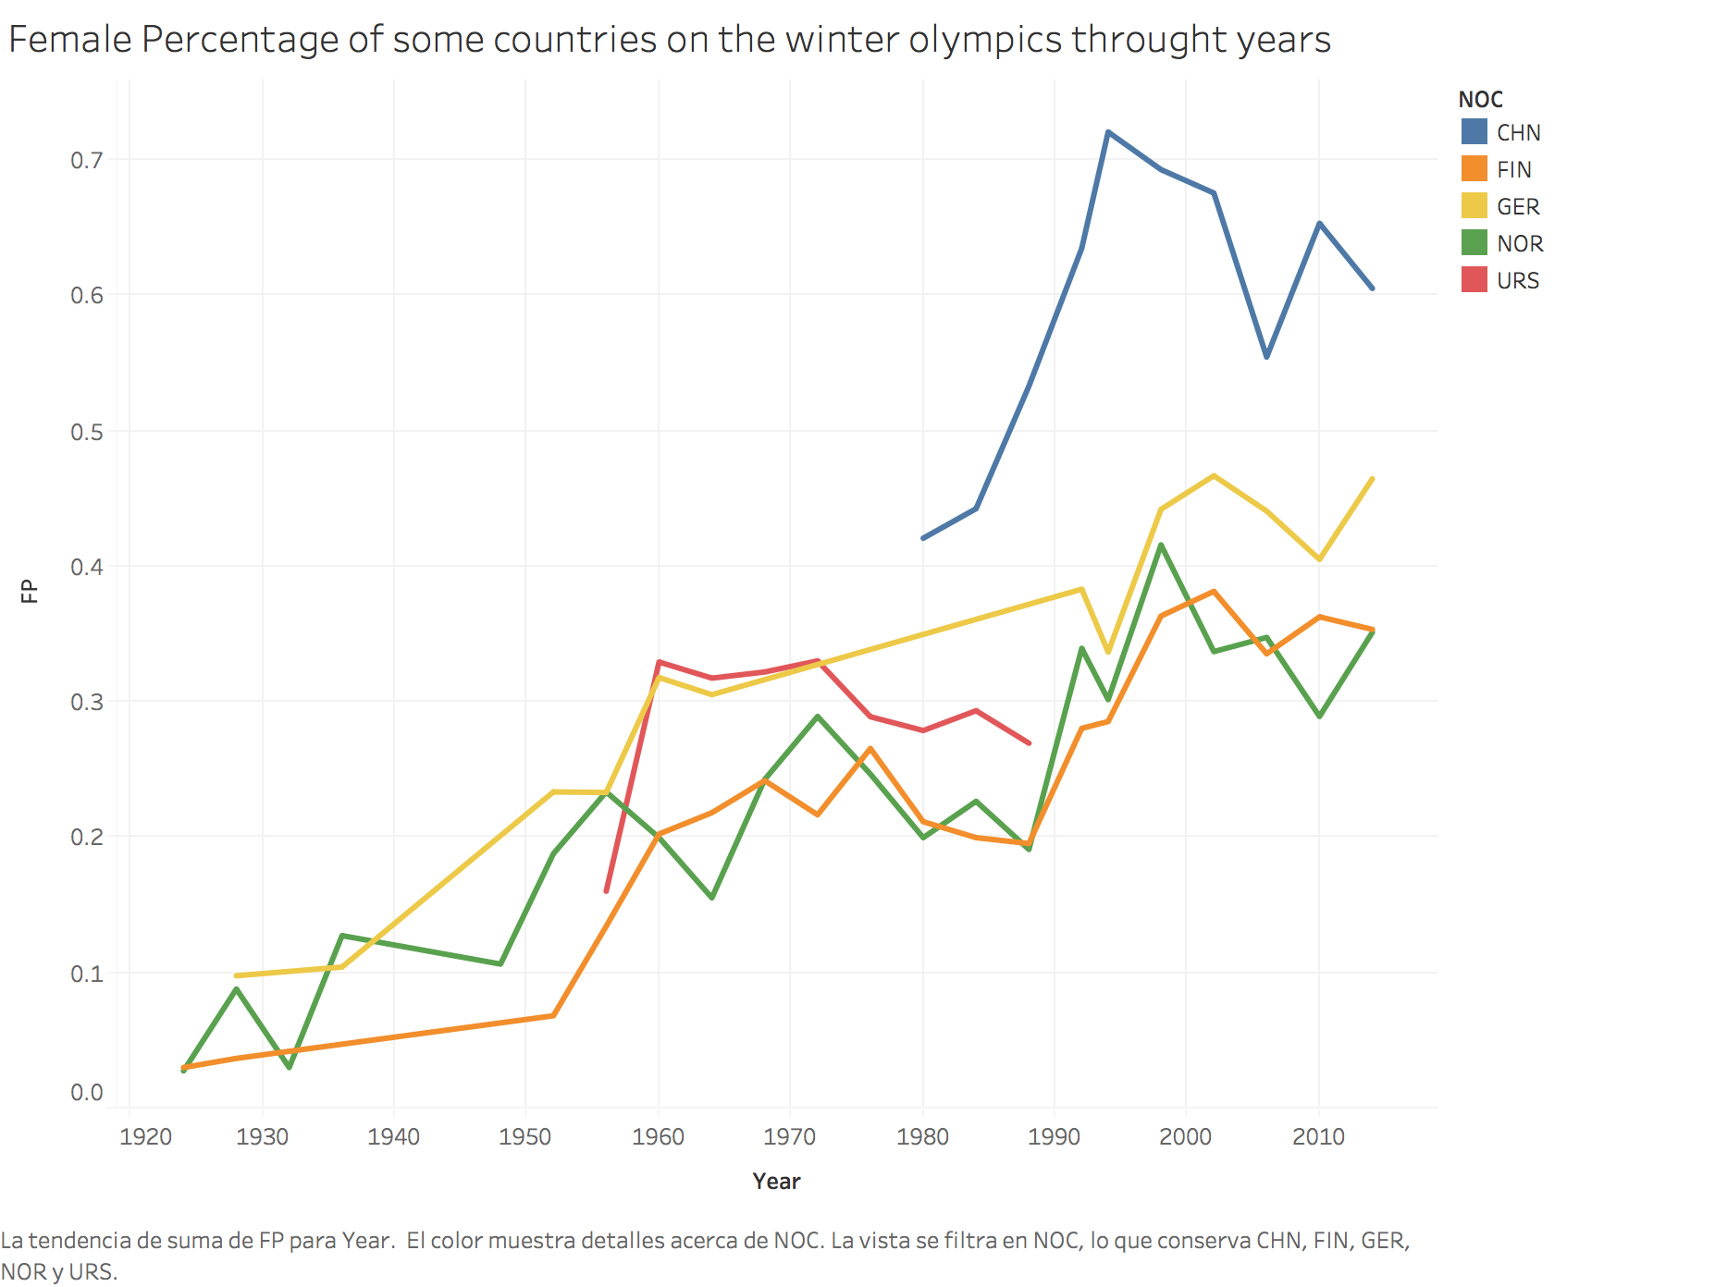

Slide 17
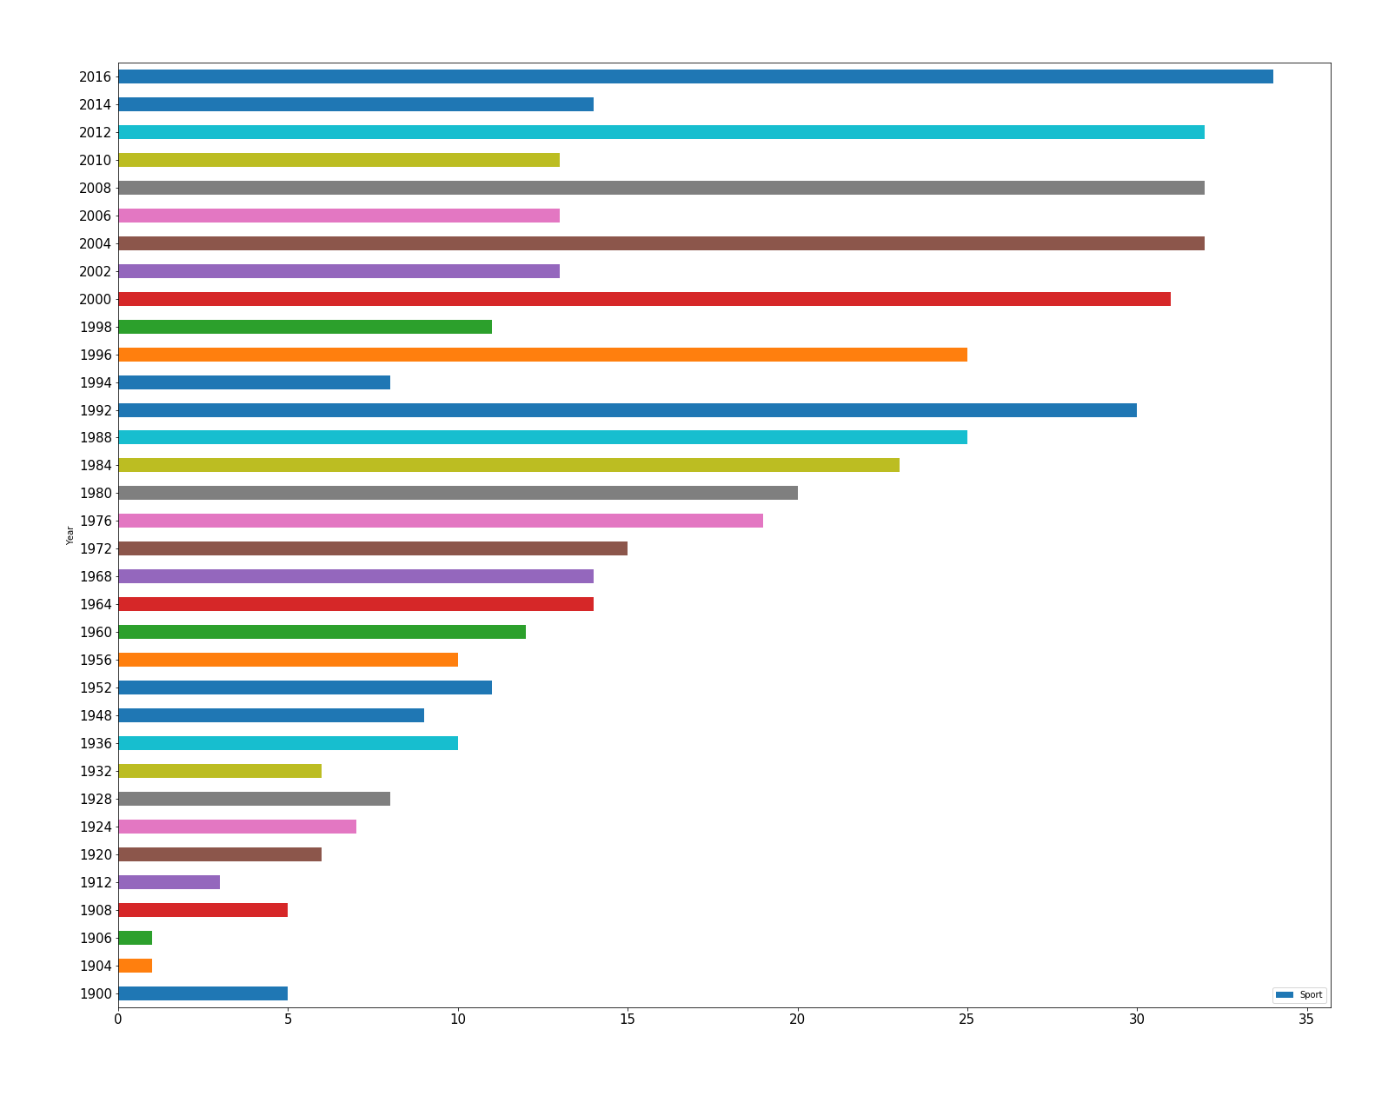
Number of Female Events Through Time
Number of Events

Slide 18
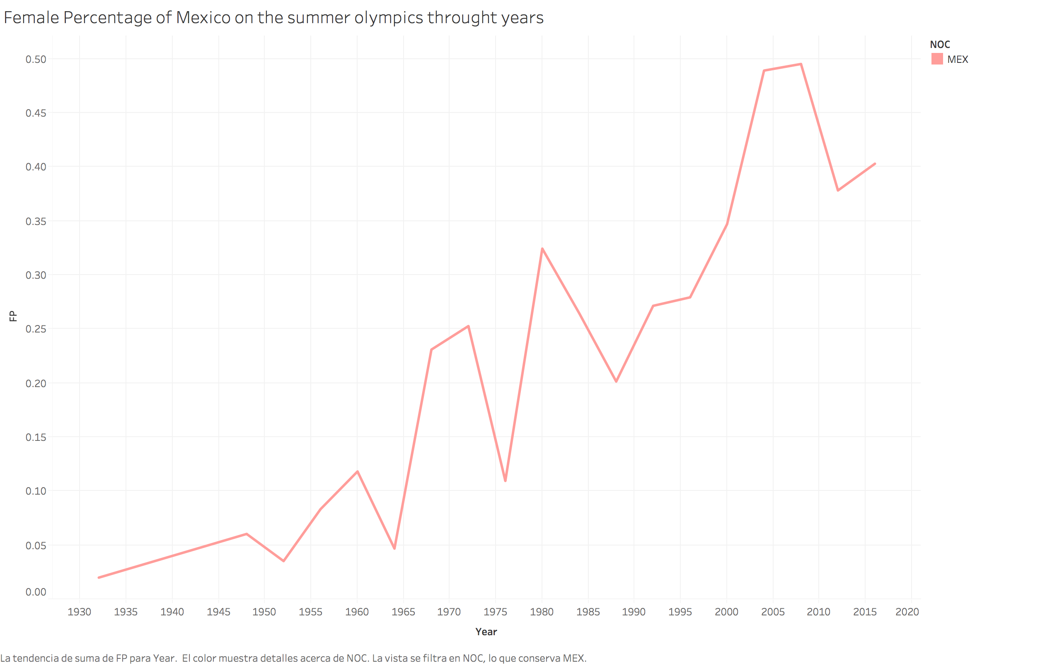

Slide 19
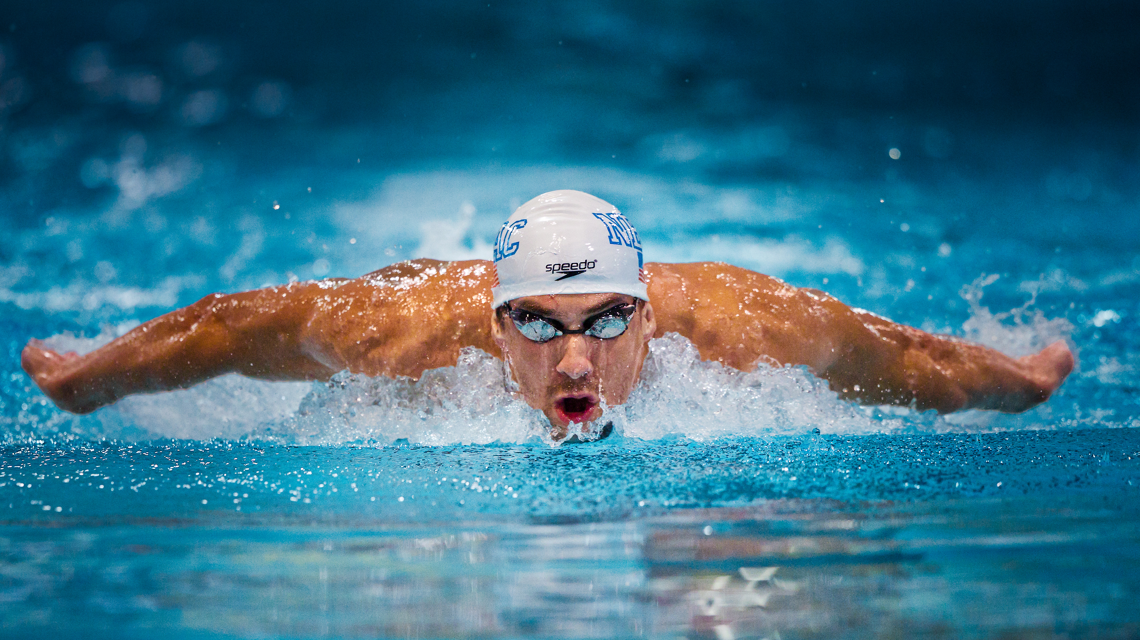
Physical Attributes

Slide 20
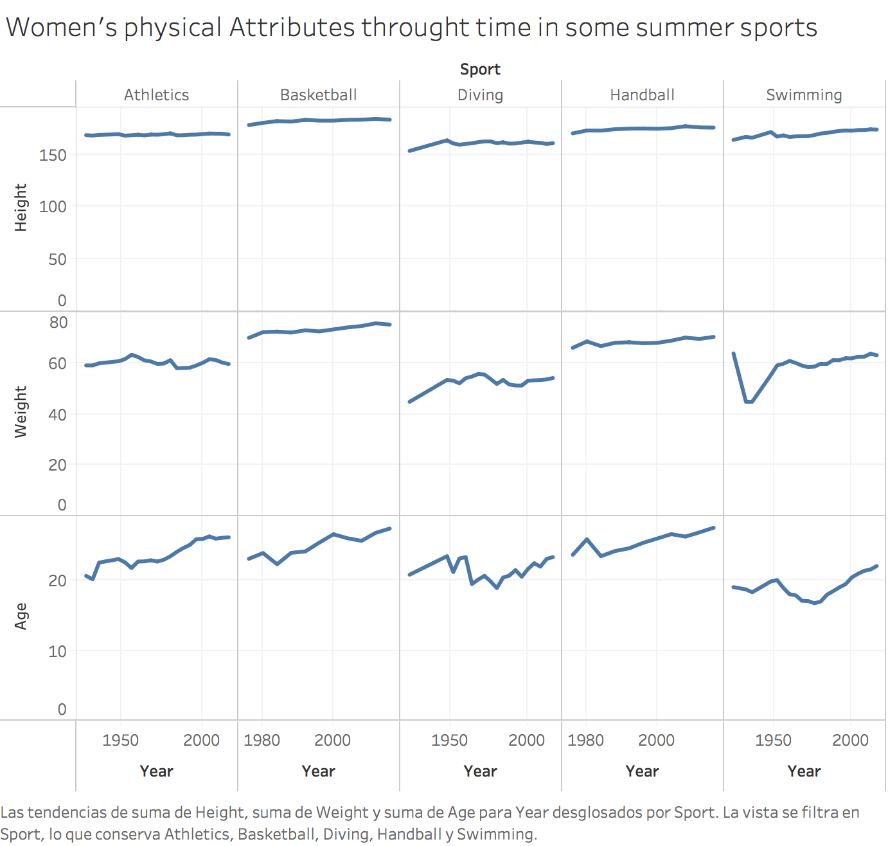
Women’s average height, weight and age through some sports.

Slide 21
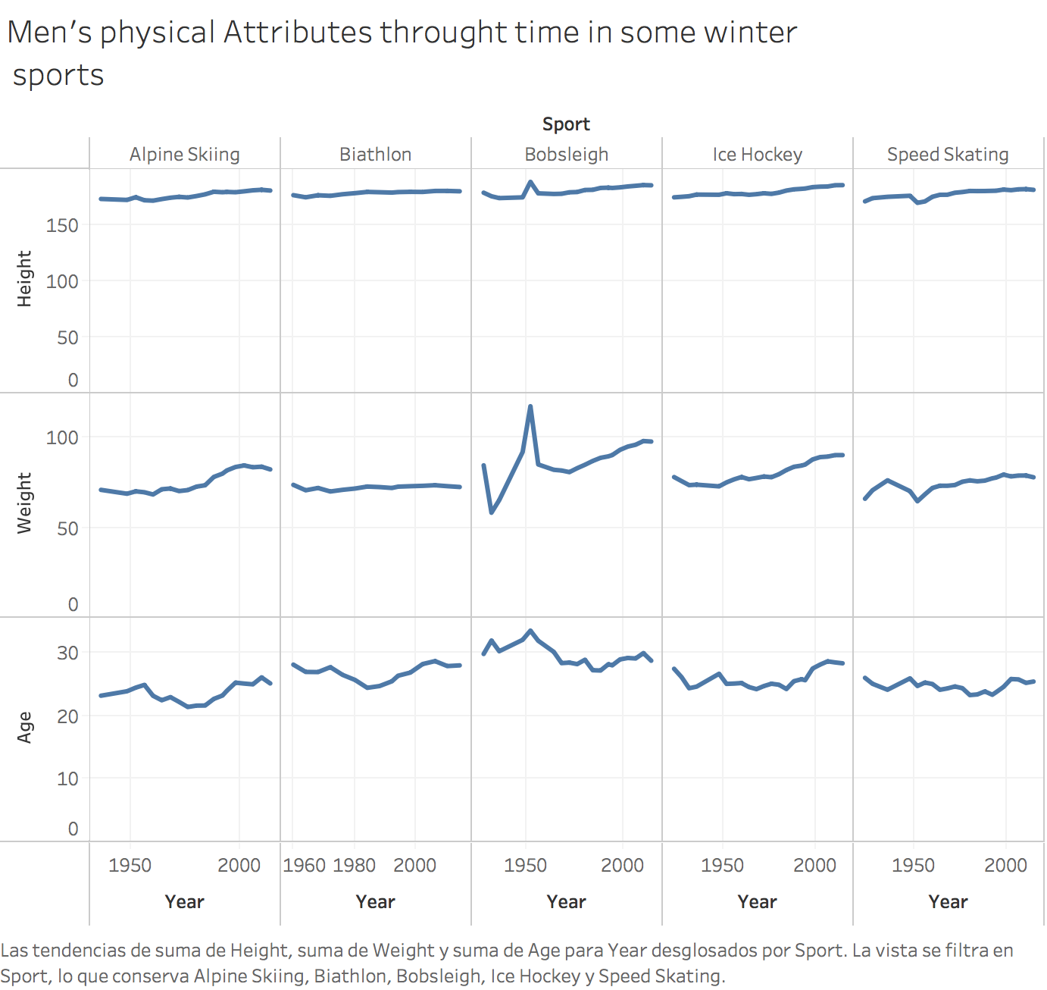
Men’s average height, weight and age through some sports.

Slide 22
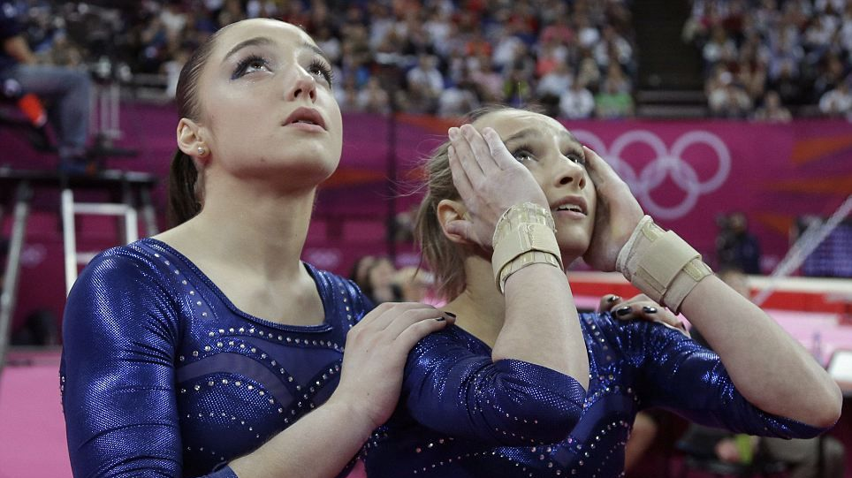
What questions remain unsolved?

Slide 23
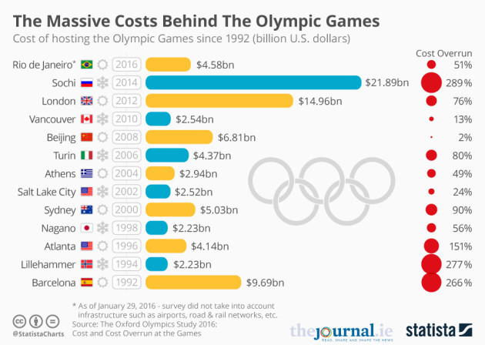

Slide 24
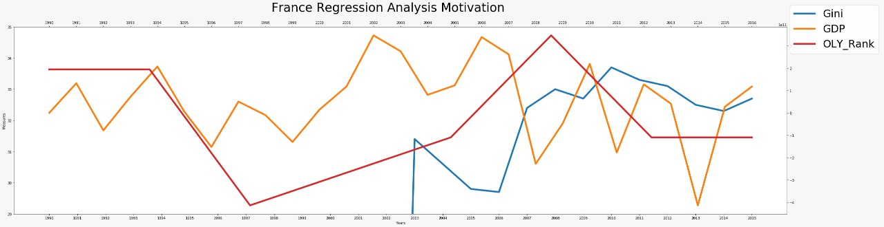

Slide 25
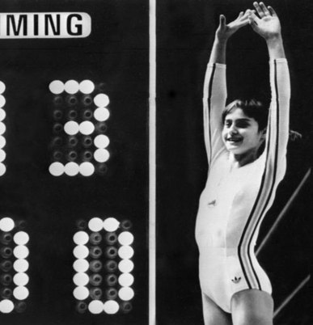
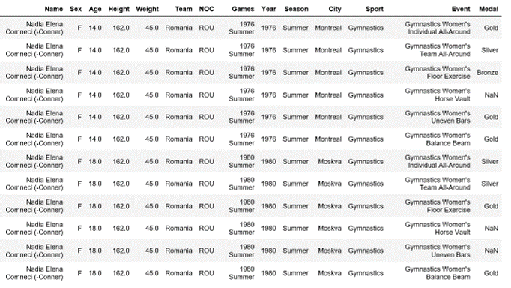
Don’t run from a challenge.
Instead run toward it because the only way to escape fear is to trample it beneath your feet.
- Nadia Comaneci

